Slide 1
Communicate with Anyone
and make it work

Slide 2
Two States
Fear State
Unbalanced
Clear State
Balanced
Bad Behavior
Best Behavior
1. Fear of Failure (I am not good enough)
2. Fear of Loss (I am not safe)

Slide 3
Fears Failure
Triggers
Mistreatment
Offended
Taken from
Disregarded
Feels unsafe
Things wrong
Unsafe
Triggers
Insulted
Criticized
Judged
Put down
Corrected
Not good
enough
Kind
Caring
People-
Pleaser
Insecure
Social
Needy
Clingy
Depressed

Slide 4
Dealing with Other People
The platinum
rule
Cure to their Fears
Validation about what they value to cure their fear
Re-assurance about what they fear

Slide 5
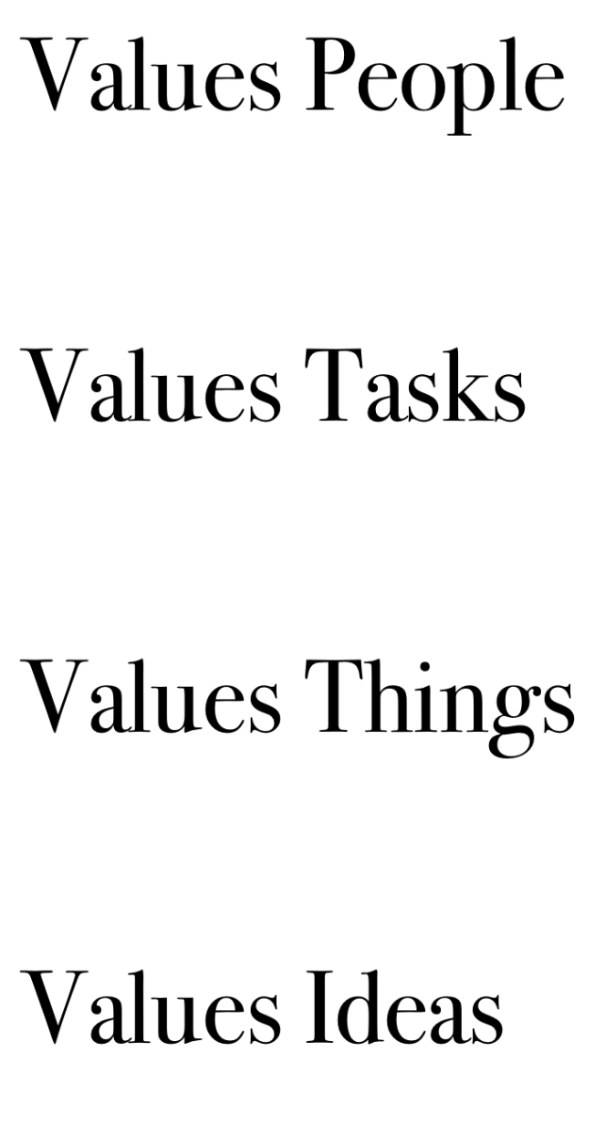
Values People
Values Tasks
Values Things
Values Ideas

Slide 6
Mutually Validating Conversations
Step #1: I choose to see this person
as the same as me.
ADULT
Fearless
Strong
Loving
Mature/Wise
Win-Win
Ego
PARENT
Win/lose
Big/Better
More Powerful
Weak
CHILD
Small/Worse
Less Powerful

Slide 7
Mutually Validating Conversations
Step #2: I set my stuff (thoughts and feelings) aside upfront.
Step #3: I will ask questions about their stuff...
(Their thoughts, feelings, ideas, opinions, fears, etc.)
… and I will listen and validate them.
(This doesn’t mean I will agree. It means that I will honor and respect their right to be where and who they are.) “I totally understand how you can feel that way.”

Slide 8
Mutually Validating Conversations
#4: I will ask ____________before I share my stuff.
Would you be open to some suggestions?
Would you be willing to let me share my feelings about this?
Would you be open to some ideas I have about this?
Would you be open to understanding how I feel about this?
#5: I will focus on what I think and feel, and on _______________ not past.
I will use “I ” statements instead of “you” statements.
I will focus on the future, and behavior I want to see moving forward, instead of their past behavior.
Permission
Future behavior

Slide 9
www.12shapes.com
Free Podcasts
Explain People
Relationship Radio

