Slide 2
Elevate the Dining Experience
Don’t Lose Sight During COVID
Maria DeNicola, MS, RD, LD/N
Business Solutions Specialist
Gordon Food Service
October 28, 2020

Slide 3
Learning Objectives
Define the risk of malnutrition due to isolation during COVID.
Describe food service strategies and creative ways to elevate the dining experience whether serving in resident’s rooms, communally or to-go.
The tools and resources available to achieve your goals.
Notes:
What are your current dining experience goals - how do you want the entire dining process to look and feel for your residents
What foodservice strategies can help elevate that experience whether due to covid you are serving in-room, communally or via a to-go program
What are some successful strategies to elevate how you market your program
Wrapping up with tools and resources to make all of this easier on you.

Slide 4
Real Talk
“Our world has changed significantly.”
“It won’t be ‘business as usual’ going forward.”
“Residents are losing weight and muscle mass.”
“I have to keep my staff and guests safe.”
“We are being forced to ‘right size’ our foodservice operations and teams.”
“We need to find new ways to get even leaner”
“It’s hard to maintain satisfaction levels, but I have to find a way.”
Notes:
Start by saying, “We hear you!”
Doing this presentation today, because we are listening and paying attention to what you are telling us and what we are seeing.
Our world has changed significantly.”
“It won’t be ‘business as usual’ going forward.”
“It’s hard to maintain satisfaction levels, but I have to find a way.”
--hospitals d/t funding
--senior living -- word of mouth / ratings
--Prepare for the Next normal -- cant continue with current methods of doing things
Current methods have their challenges -- ineffective in a lot of cases -- Residents are losing weight and muscle mass. we hear of residents losing weight and muscle mass. In some cases, “adequate nutrition” is not happening

Slide 5
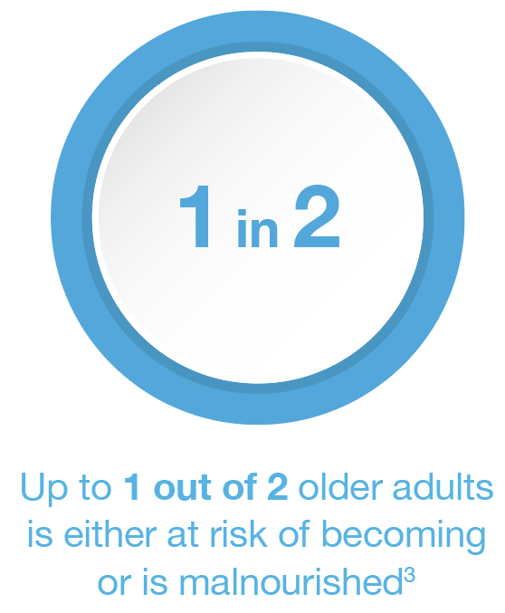
NUTRITION AND THE U.S. POPULATION
Malnutrition is intensified by the disparities and social isolation from COVID-19 pandemic.⁴
Additionally, nutrition status is a relevant factor influencing the outcomes of patients with COVID-19.⁵
Malnutrition Prevalence Across Care Settings
Notes:
https://www.defeatmalnutrition.today/sites/default/files/National_Blueprint_MAY2020_Update_OnlinePDF_FINAL.pdf - [AL: UPDATED]

Slide 6
POTENTIAL RISE IN MALNUTRITION RELATED TO COVID-19
APPETITE
SOCIAL ISOLATION AND LONELINESS
ARE ASSOCIATED WITH A
HIGHER RISK OF MALNUTRITION
SOCIAL ISOLATION AND LONELINESS
DIET QUALITY
ENJOYMENT OF FOOD

Slide 7
Why Are We Discussing the Dining Experience?
The Potential Impact of COVID
Social isolation can impact diet quality, appetite, and enjoyment of food
Social isolation and loneliness are shown to be associated with a higher risk of malnutrition
Notes:
We often talk about “Food as Medicine.” Right now, food has the potential to be much more than medicine.
We know food often can provide comfort or something to look forward to throughout the day.
But as we’ve seen on the previous slide, the Impact of COVID is far-reaching.
Because of the impact of uncertainty and isolation, food may not be living up to its potential to be physical OR emotional medicine.
Social isolation can impact diet quality, appetite, and enjoyment of food
Social isolation and loneliness are shown to be associated with a higher risk of malnutrition
isolated older adults often experience a loss of appetite, eat fewer meals during a typical day and with this have a lower intake of protein, fruits and vegetables.2,3
However, as arrows illustrate, increasing dining satisfaction levels can help decrease malnutrition.
With increased satisfaction, we see better infection control, weight maintenance and emotional well being.
We see fewer falls and pressure injuries.
All in all, better satisfaction leads to higher quality outcomes and 5-star ratings which can impact us financially.
We must focus on this area.
I’ve explained where we are now, amid covid...but our patients were not malnourished to this extent, prior to COVID. What have you seen over the years and how did we get to the point we were at, pre-covid.

Slide 8
KEY POINTS
Malnutrition increases the risk of poor health outcomes & raises the cost of care to the healthcare system
Care organizations receive financial incentives to advance health & decrease costs
Focus strategy: Prevent & manage malnutrition to improve overall outcomes

Slide 9
FOOD AS MEDICINE: THE CONNECTION BETWEEN WELLNESS & FOOD
Let food be thy medicine and medicine be thy food.
Hippocrates
Reduction in pressure ulcer incidence
Decrease in avoidable readmissions
Notes:
We often talk about “Food as Medicine.” Right now, food has the potential to be much more than medicine.
We know food often can provide comfort or something to look forward to throughout the day.
But as we’ve seen on the previous slide, the Impact of COVID is far-reaching.
Because of the impact of uncertainty and isolation, food may not be living up to its potential to be physical OR emotional medicine.
Social isolation can impact diet quality, appetite, and enjoyment of food
Social isolation and loneliness are shown to be associated with a higher risk of malnutrition
isolated older adults often experience a loss of appetite, eat fewer meals during a typical day and with this have a lower intake of protein, fruits and vegetables.2,3

Slide 10
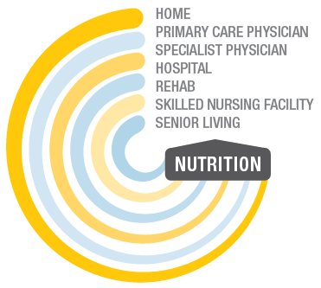
PERSON CENTERED & NUTRITION INTERVENTION STRATEGIES
Malnutrition programs & the interdisciplinary team
Care transitions
Community partnerships
Elevate the dining experience
CONTINUUM OF CARE
Notes:
This image is from one of older our GFS Whitepapers. Let me know if you need the link and I’ll look for it

Slide 11
KEY POINTS
Person-Centered Strategies
Think Triple-A
Atmosphere - Promote comfort and dignity
Assistance - Empower maximum independence and dignity
Alternatives - Offer true choice and self-determination
Notes:
And for the dining experience, Always Keep Triple A in mind …
Atmosphere
Assistance
Alternatives - meaning true choice in where, when and what to eat.
So that you may provide an enhanced dining experience, influencing a lower prevalence of malnutrition
And therefore, better infection control, better weight maintenance, fewer falls, fewer pressure injuries, and an improved emotional well-being,
All resulting in high quality outcomes and 5 star ratings

Slide 12
The Dining Experience Mission
From Tray Service to Restaurant Style Dining
We cannot lose sight of person centered care and all of the time and resources put into the home-like experience that everyone has strived for over the years.
Where was your dining experience prior to COVID? Has dining been a team effort in your community?
What was the level of satisfaction of your patrons/families?
Did you have goals that you were striving for that stopped suddenly?
Are you able to pivot easily between styles of dining based on the levels of “normal” we are experiencing?
Notes:
We have spent almost 15 years trying to create a different experience for our residents in terms of choice and a home like environment. We need to continue to push through this and keep this at the forefront as much as possible through the times we are living in now and beyond. Dining is still an extremely important marketing tool for your community, so to not have a plan to navigate these times would be detrimental. Were you happy with the dining experience prior to COVID and was your entire team involved in the process? If not, now is the time to involve everyone from the top down to set goals for the experience. Do you know what the level of satisfaction was for your residents/patrons/families and were you possibly trying to achieve goals to improve that experience? In mid March, the focus certainly shifted, as it should have! However, you can’t lose sight of what the resident really needs long term. Therefore, we need to be able to pivot easily between styles of dining based on what the community is experiencing in senior living specifically during these uncertain times. These levels of “normal” need to truly be that to resident and families in terms of how they are receiving their meals and participating in the entire experience. They need to feel safe and confident throughout the process.
Practical foodservice strategies
Pivoting between in room and communal
Resident Council?
Acute Care - getting feedback from Press Ganey, etc
Feel safe and confident -- go back to basics to see what their needs are

Slide 13
Going Back to the Basics In Order to Move Forward
Establish Your Baseline
Improve
Innovate
Where are you now?
Self-audits?
Surveys?
Real-time data/info?
Back to the basics with “best practices.”
Ensure all audit processes are completed
All hands on deck - entire organization
Atmosphere
Experience
Assistance / Support
Reset and rethink to adapt to new normal
Creativity
New ways of doing things
Notes:
In order to move forward, we need to actually take a step back and Establish our Baseline.
We need to figure out where we are before we try to move on and get where we need to be.
We can do this with those tried and true basic tools:
Start by doing a good, old fashioned audit to take a deeper look at your operation
We often forget the basics. Are you still using a trayline or not?
Simple things like serving hot food hot can be challenging because our entire method of operating has been turned upside down.
An audit can help identify areas that have gone awry and impacted your meal service and ultimately resident or patient satisfaction levels.
Discover your resident or patient satisfaction through a survey
Great way to discover areas that need attention
But surveys usually only capture the good/bad after the fact
To capture and react to “bad” things happening OR to reinforce “good” things as they happen, collect real-time, on the spot data. We will talk about ways to do this in a few slides
Improve where you see opportunities to get better
You’ll likely need go go Back to the Basics of “Best Practices” -- For some of this, you may need to network with us or peers for ideas on what’s working now amid covid
For this to work, needs to involve the entire operation
That means, as you determine “where you are at,” need to look at how things are happening from back of house to front of house
What’s happening from when food leaves the walk in cooler to the time the meal reaches your resident to when dishes are picked up and returned to kitchen
Atmosphere
Experience
Assistance / Support
Adapt / Innovate
If anything is awry, here is where you’ll need to get creative.
There is no single solution that will fit everyone but you need to find solutions that work for your location
There are things from “before” that you can (and should) still do now, however it’s critical to think and plan for how to do it differently or better in COVID-times
We don't have the freedoms and capabilities we used to have.
We have to make best of what we can safely do and provide now and find new ways of doing things

Slide 14
“You don’t have to have it all figured out to move forward. Just take the next step.”
Anonymous
Notes:
So as we think about innovating, remember this quote--
“You don’t have to have it all figured out to move forward. Just take the next step.” Anonymous

Slide 15
Establish Your Baseline

Slide 16
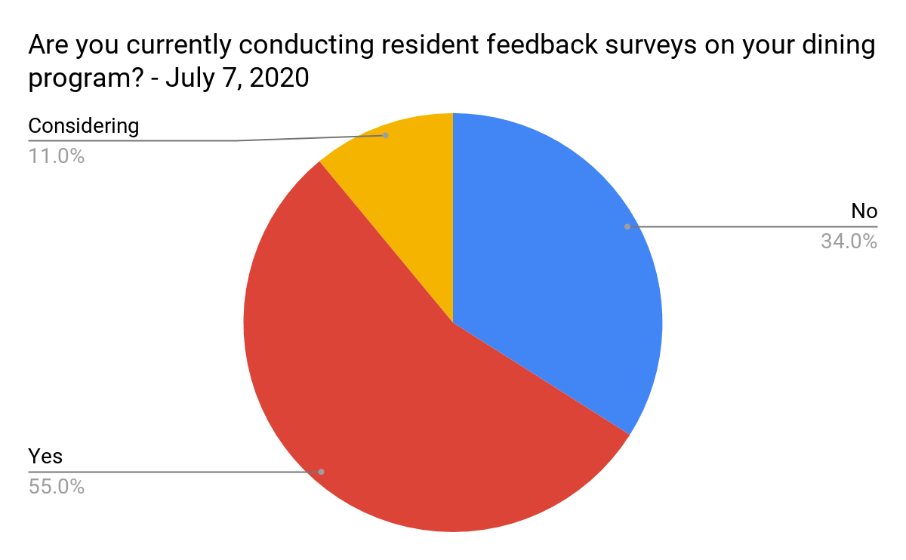
Establish Your Baseline
Notes:
Senior Dining Association ran a poll In July and asked operators " Are you currently conducting resident feedback surveys on your dining program?"
The results, shown on your screen, showed that the majority of operators are surveying their residents. But 45% were not or only considering doing it.
55% of respondents said they are conducting resident feedback surveys on dining programs
34% of respondents said they are NOT conducting resident feedback surveys on dining programs
11% of respondents said they are CONSIDERING conducting resident feedback surveys on dining programs
We know how important food and mealtimes are during normal times, even more important now to ensure they are satisfied with what you are serving them. There is no time but the present to check in with residents.
We’d like to take a moment to poll all of you to find out more about what you are doing today, Sept. 17 2020

Slide 17
Establish Your Baseline
Collecting Feedback
Resident Council
Resident Surveys
Calling or stopping by
Nursing Comments
Family Surveys
*Share results with Food & Nutrition Services team members*
How are meal deliveries going?
What can we improve on?
How safe do you feel?
Notes:
Ways to collect feedback If you are not...
How can you collect feedback or perhaps grow the feedback you are collecting?
Resident council meetings may be out -- unless can do this distantly, perhaps even outside
Can still do the usual surveys, comment cards
Can also call or stop by rooms
Assign staff member to randomly select a certain number of residents to contact after meal that day (10 per day??)
Nursing -- direct line of contact
Family surveys if you feel they have had enough contact with their loved ones
Whatever method, reach out to ask
What can we improve on?
What are your favorite menu items? What else do you want to see?
How safe do you feel (about returning to / now that we’ve returned to) communal dining?
If you have the capacity to expand in the future, ask about what kinds of services they may want to see -- Do you want grocery delivery?
Ideas for food activities that will bring them and their peers joy
If meals in room -- how are the deliveries going? Texture, temp, taste, timeliness, issues with delivery person? Quality of food once in room -- soggy bread? Soggy toast? Limp greens?
If there are issues with these things and you are having trouble fixing it, talk to us or talk to your rep. If the food quality is an issue by the time it reaches the room, perhaps not the right products or menu items.
Customer service training -- we can help with that.

Slide 18
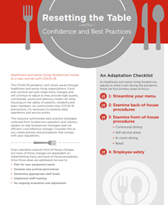
Back to Basics
Implement Various Audit Tools
Resident/Patient Survey Process
Taste Tests
Test Tray
Tray Accuracy
Meal Rounds
Leader Rounds
Comprehensive Department Audit
Foodservice
Infection Control
Notes:
Taste tests -- how are your recipes?
Test trays -- to evaluate the quality of a meal during a normal meal service
identify any areas for improvement.
Can help you
identify quality improvement issues and use results as a reportable quality performance indicator.
Look deeper into complaints or reported issues with meals or specific menu items and analyze and react to the cause
Objectively and subjectively score or rank meals and menu items
Tray accuracy -- residents receiving what they expect and should be getting?
Meal Rounds and leader Rounds -- get administrator or upper management involved so they can see what areas need attention and get resources behind fixing them
Department audit
Food safety -- food storage, time/temp controls
Infection Control and Personal/Staff Safety -- How handling trays from patient (specifically isolation) rooms/units, cleaning and sanitizing dining rooms, PPE use

Slide 19
Dining Experience Audit
Comprehensive Dining Experience Audit
Production & Culinary Practices
Meal Assembly
Tray / Table Presentation
Tray / Dining Room Service
Food Quality
Safety
Employee Training & Performance Improvement
Notes:
After you talk to your residents, nursing staff and families, another “back to basics” tool is a Tray Audit
Residents Top Concerns:
Choice
Proper temperature and size
Show me dignity and respect
Talk to me directly even if you think I’m “too confused”
Don’t decide for me
After you talk to your residents, nursing staff and families, another “back to basics” tool is a Tray Audit
It is easy to forget the basics
So many moving pieces in your operation
Each, presents an opportunity to look into potentially find an area to improve - which will ultimately positively impact your dining experience.
Start BOH looking at Production / Culinary Practices
Focus first on standardized recipes
available
used consistently
→ determines whether or not your residents or patients can rely on the same quality meal, on a regular basis
No one wants to have to guess how the lasagna will be today or the pork loin tomorrow
Advance production
what makes sense ? What can be prepared in advance?
What menu items need to wait?
Have you adjusted production schedules to better position yourself from a staffing standpoint (to prevent or react to labor shortages)
Hold times -- due to extended service hours may need to do more Smaller Batch size cooking to maximize food quality
One of our customers worked on making own trays in advance and freezing them in anticipation of patient surge
Patients still able to have chef-prepared meals but trays only needed to be re-heated with COVID surge -- didn’t have to rely on purchased trayed meals
Great way to address/bypass potential labor issues
Regular production meetings taking place to address issues, fill your staff in on changes OR just to motivate them and give praise. Are they well attended?
Meal Assembly
proper temp maintained and documented from beginning and end of food prep process
Taste test conducted before each meal -- adjustments made?
Proper serving utensil sizes readily available? Staff trained on portions? Do they have production sheets available to tell them what to do?
Tray / Table Presentation -- first bite is with the eyes
Tray / Dining Room Service
Who is delivering? How is customer service?
Food Quality
Soggy? Hot?
Safety -- Food, infection control, staff safety
Do your residents /patients FEEL safe in dining room? In their room?
Do they know (and see) all steps being taken to ensure their safety so they WANT to eat with you and can enjoy the meal.
As you work through this, you will be able to identify areas in need of Employee Training & Performance Improvement

Slide 20
In-Room “Room Service” Dining
Notes:
In-Room versus “Room Service” Dining -- think of hotel and Hospitality. It’s LOVELY to get breakfast served to you in your room! “Steal” name from other “hospitality” industries because. Whether sick and eating in room at hospital, LTC eating in room (which is their home), no better places to want/need to feel safe and comfortable.
It’s all about the “feels” :)

Slide 21
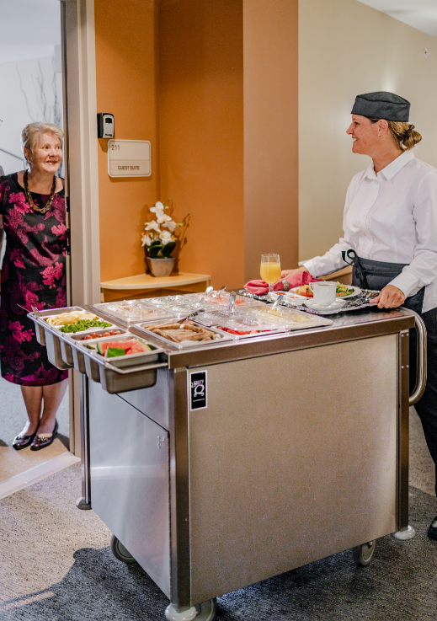
ELEVATE THE DINING EXPERIENCE IN SENIOR LIVING
Don’t let your guard down during COVID-19
Source: SuzyQ Carts
Notes:
Food is only nourishing if they eat it
Why aren’t they eating?
Shift control from pre-determined to self-determination, go mobile

Slide 22
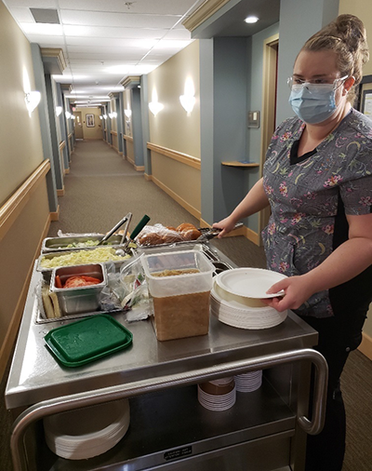
Room Service Dining
Keeping the Experience Dignified
Choices
How many
Preferences obtained
Preferences adhered to
Customization
Notes:
Choices
You want as many Choices as you can effectively manage from supply and labor standpoint:
But another part of choice is are your resident’s or patient’s food preferences obtained and adhered to?
One way to do this if you don't have this through technology is by setting up a Buffet or Trayline on Wheels and “customizing” at last minute to individaul order requests
See in pic offering burgers with choice of topping. Plated fresh in hall so food is fresh / hot (not soggy bread and limp lettuce) and ability to offer individualized choices
Next week → Culinary team will have ideas for how to transport dishes and serve them to maximize food quality and temp

Slide 23
Room Service Dining
Keeping the Experience Dignified
Menu
Appeal
Redundancy
Types of products / recipes used
Seasonal or special menu items
Notes:
Even if confined to serving residents in room, still need to stress a dignified dining experience
At first, everyone flipped to serving on styrofoam with IW flimsy plastic sporks. That was fine to get us through at first….but let’s dive deeper bc we all know, this is a much longer term situation.
MENU
We know many have had to reduced the number of total menu items, and overall variety due to COVID. Also removed customization / cook to order options.
Sure, this is effective way to protect against supply chain and staffing issues and avoiding having cash flow tied up with inventory, but what are the effects of this on your dining experience? These were put in place to help ensure you could continue to provide meals but do you residents / patients / guests understand the why” First step is to communicate the “why” for the reductions but then consider if if there are other ways around this.
As residents consider the menu, is it appealing?
If you have reduced the menu, it should focus on patient or resident favorites -- the hot items
Is it redundant?
Have you changed it recently?
What types of products / recipes on menu?
Is menu mainly made from convenience / speed scratch / scratch items?
Many foodservice operators who previously had cooked from-scratch are relying on and finding success using more speed-scratch:
Starting with partially prepared recipe components -- such as sauces or braised meats -- allows kitchen staff to get more done with fewer labor hours (saving labor $)
Can more easily take core menu and adapt to incorporate seasonal flavors
Can cross utilize those core ingredients to reduce inventory (and save inventory $)
--> Next week, chef’s will share more
Can also often find recipes on manufacturer websites
Consider having multiple menu variations -- convenience and speed-scratch, for example, and flipping to the option you need, based on labor or COVID status
Can you elevate the always available menu
i.e. I heard from one customer wanting help selecting some of our Halpern’s meat so they could offer an “affordable” cut of beef, such as flat iron steaks or chuck steaks. I loved this idea!
Can you add variety via LTOs?
Strategy seen in restaurant world and often suggest to our K12 or C&U operations.
Consider, can you take advantage of special manufacturer rebates or seasonal items and introduce a month long limited time offer menu feature?
Perhaps putting a seasonal special on your always available menu (chili and cornbread)
Maybe it’s a sub-set of your menu you focus on.
I.e. Make great soups? Keep your smaller menu but also introduce Seasonal Soup Saturdays?
Or take the beverage route and do Saturday Sips with a seasonal beverage -- always love a good cocktail / mocktail! Pumpkin spice season is upon us….

Slide 24
Room Service Dining
Keeping the Experience Dignified
Ordering Process
Advance ordering
Opportunity to adjust order
Do residents / patients understand the process
Ease
Notes:
Ordering process
Have you implemented advance ordering to help with production and reduce contact?
Great from safety standpoint but are you asking individuals to order too far out? How many days in advance are you requiring? People change their minds.
Indep Living customer that provides residents daily menus and has volunteers pick them up by 10 a.m..
Kitchen staff makes the tickets and staples them to the bags with the room # and resident order.
Other residents can call into a reservation line and use the same process .
Have a wide delivery time of 11:30 - 4:30 p.m. and they take out about 60 meals at a time.
Using disposable microwavable containers.
Whatever the ordering method, Is that a smooth process? Do residents/patients understand the ordering process? Dp you know if they are satisfied with it?

Slide 25
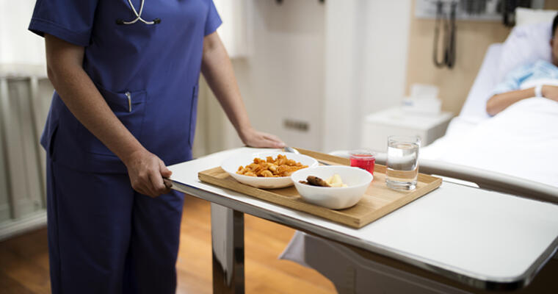
Room Service Dining
Keeping the Experience Dignified
Delivery / Service
Food covered
Condition of carts
In-room interaction
Assistance with meal
Notes:
Delivery / Service
Food covered during transport and distribution?
Meal carts in working order? How do they look? Need new ones?
Who is delivering tray? Where are they placing it? Within resident’s reach?
Assistance provided opening containers and condiments
What is that delivery experience like for the patient/resident?
In-room interaction
whomever is delivering the to the patient or resident is likely one of the only person that individual gets to interact with during the day -- Placing greater importance on this final piece.
Common hospitality, warmth and that extra step can go a long way in making that meal service be valued.
Due to COVID, this delivery may be out of your control if nursing is delivering meals
Coordinate with them to help ensure meals are delivered the you you intended them to be delivered -- while food is hot. Can be challenging dt all tasks placed on nursing

Slide 26
Creating the Dining Experience Your Residents Crave
Amid COVID-19

Slide 27
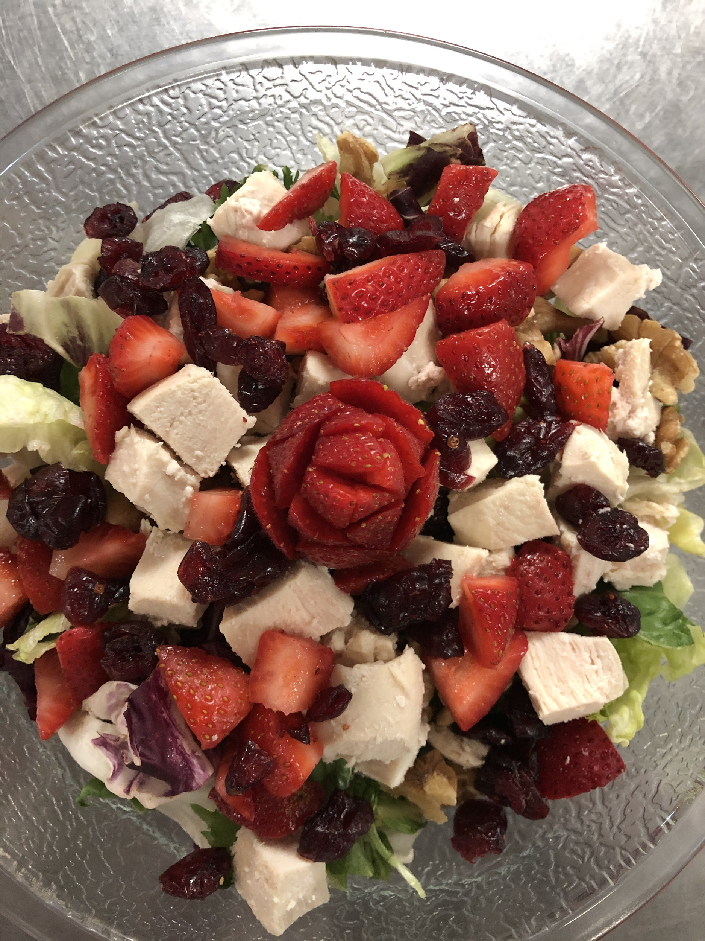
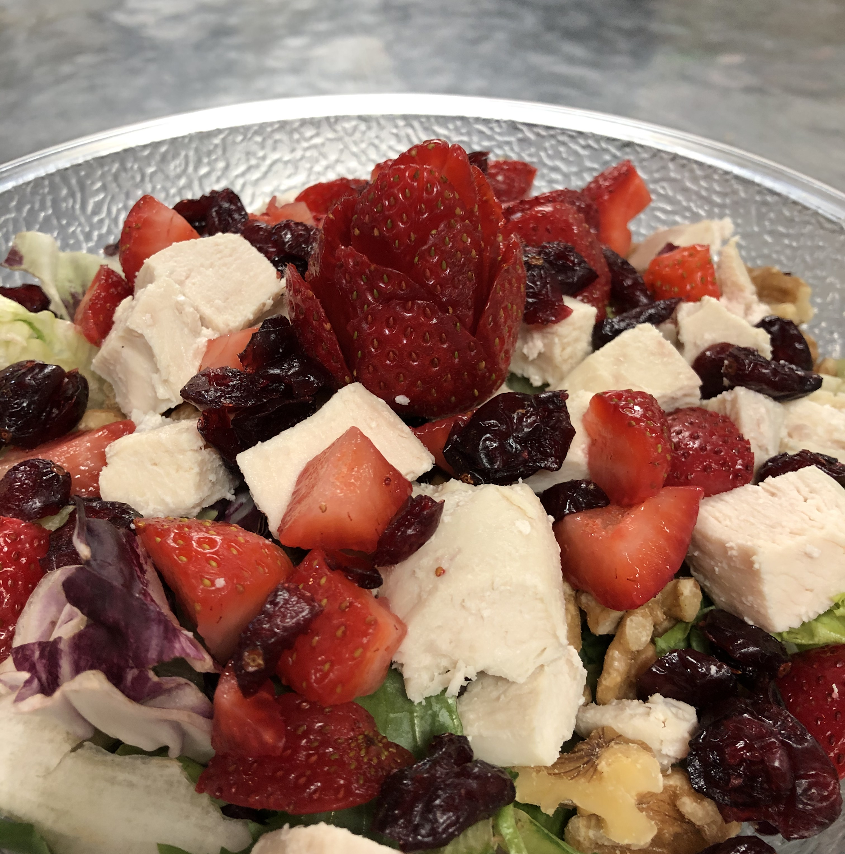
Consider the following key points & strategies
Key Points
Food As Medicine
Hot Food Hot / Cold Food Cold
First Bite Is With the Eyes
“Elevate” Strategies
Visual appeal
Versatile, “elevated” menu ideas
Menu trends
Community / Staff meals
Food transport
Fun with Happy Hour
Notes:
Key Points
“Elevate” Strategies
Plating
Garnishing
Menu versatility amid staffing concerns
Menu trends that work in-room, communally or in retail
Community / Staff meals
Food transport
Fun with Happy Hour
Q&A
Explain photos -- Customer sent these in after last week’s event to show example of simple way prep cook elevates meals.
Brought joy to my heart and can imagine how it would brighten any individual’s day
I share this for two reasons, one, it’s a great example of how important visual appeal is, and how simple the “elevate” concept can be executed.
Second, if any of you are doing great things, I would LOVE if you sent in pictures of your work! Especially now that we can’t get inside your walls to see with our own eyes.

Slide 28
Visual Appeal
Importance of using real dinnerware whenever possible
CDC says regular washing/sanitizing is effective methods of cleaning to protect against COVID-19
Examples of nicer-looking disposables
“Extra special touches on tray
Scented towelettes
Sanitizable, re-usable, “pretty” placemats
Notes:
Universal Precautions.
CMS guidelines do not have specific ruling re: using china vs disposable ware
Interim Infection Prevention and Control Recommendations for Healthcare Personnel During the Coronavirus Disease 2019 (COVID-19) Pandemic
“Management of laundry, food service utensils, and medical waste should also be performed in accordance with routine procedures.”
The combination of hot water and detergents used in dishwashers is sufficient to
decontaminate dishware and eating utensils. Therefore, no special precautions are
needed for dishware (e.g., dishes, glasses, cups) or eating utensils; reusable dishware
and utensils may be used for patients requiring Transmission-Based Precautions. In the
home and other communal settings, eating utensils and drinking vessels that are being
used should not be shared, consistent with principles of good personal hygiene and for
the purpose of preventing transmission of respiratory viruses, Herpes simplex virus, and
infectious agents that infect the gastrointestinal tract and are transmitted by the
fecal/oral route (e.g., hepatitis A virus, noroviruses). If adequate resources for cleaning
utensils and dishes are not available, disposable products may be used.

Slide 29
Visual Appeal
Visual appeal of Food
Plating
Color Contrasting
With food / dinnerware / disposable container
With colorful vegetables → RSS Rainbow carrot coins (skilled labor)
Garnishing

Slide 30
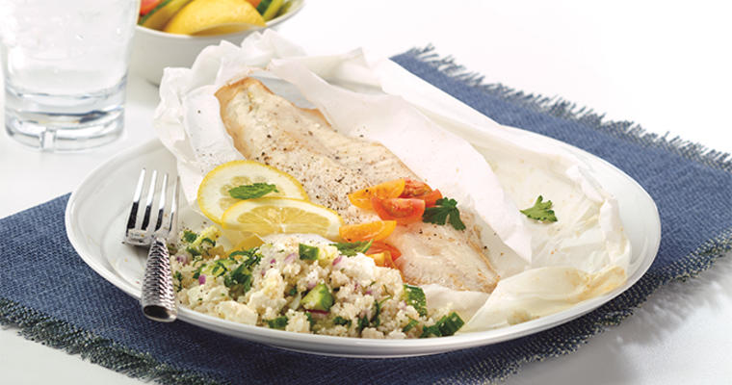
Room Service Dining
Keeping the Experience Dignified
Meal appearance
Colors
Special touches
Serving “vessel”
Notes:
Tray Presentation -- will cover more in next slide
Color of food / dinnerware
Have you included special touches
Tray / table
Real or disposable dinnerware

Slide 31
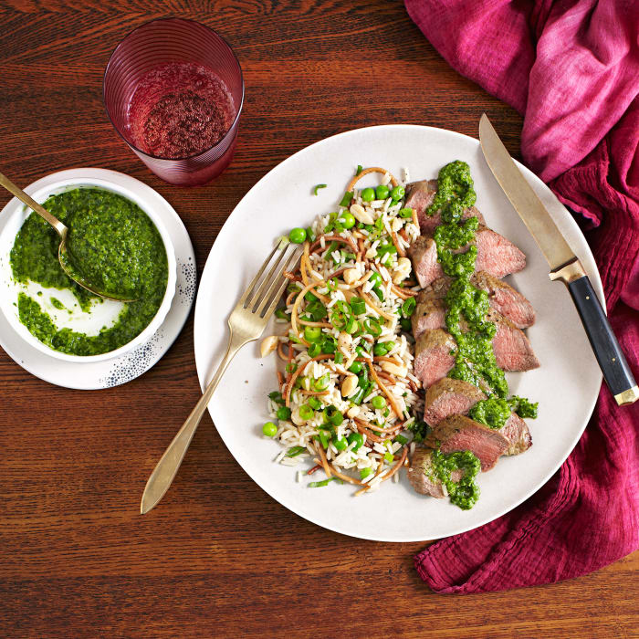
Room Service Dining
Keeping the Experience Dignified
Meal quality
Temperature
“To-go” appropriate menu items
“Extras” accessible and included
Notes:
Food / Meal Quality
Checking if food / beverages served at right point of service temperature?
If temp not right, what is your corrective action? Where is the problem arising from?
production, packaging or transportation
To-Go appropriate -- look at what’s being served. Are you serving the right kinds of foods in-room? Not all foods travel well. May want to adjust menu. (i.e. pizza can get cold and soggy -- calzone, which is similar to pizza, travels better)
Extras included and accessible -- did you include and can they access or open condiments or other containers?

Slide 32
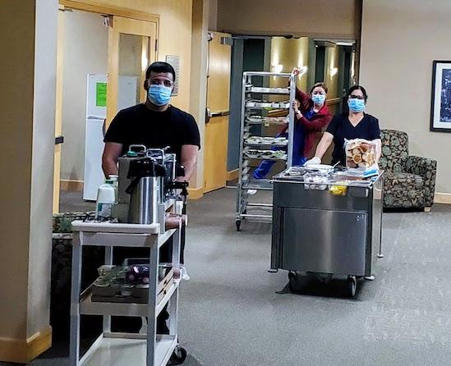
ELEVATE THE DINING EXPERIENCE IN SENIOR LIVING
Don’t let your guard down during COVID-19
Source: Food Management
Notes:
All hands on deck
Protected meal hour
Put your management team on a coffee serving schedule!

Slide 33
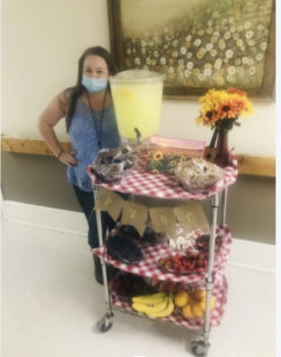
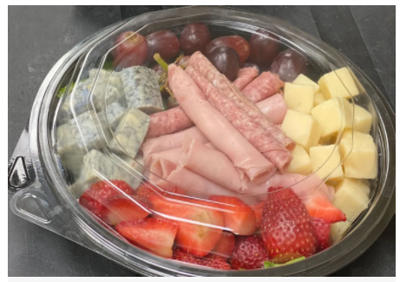
In-Room Dining Experiences
Keep the Experience Exciting
Traveling Room Service / Specialty Carts
Root Beer Floats/Ice Cream Novelty
Popcorn, Chips/Salsa
Yogurt or Pudding Parfaits
Local Fun Friday Treats
Dessert Cart
Beverage Cart
Mocktail Happy Hour
Specialty Lemonades
Wine/Charcuterie/Cheese /Crackers
Support
Image
here
Notes:
Keeping it exciting!
Several great traveling room service cart ideas from my customers -- snack carts great way to get additional calories in, to address malnutrition issues
Root beer floats
Ice Cream Man!
Ice Cream Novelty treat cart with several varieties to choose from (a resident Favorite!)
2 varieties of parfaits with fruit and granola on the side -- can customize for each resident
Popcorn cart -- different flavors available
Chips and salsa cart
Pair with a lime-flavored refreshing beverage. :)
Beverage Cart -- we know hydration is always an issue
Mocktail or Real cocktail Happy Hour using flavored syrups OR specialty Lemonadtes -- Spero (non-foods team) will have ideas next week
Friday appetizers
Wines, charcuterie, cheese and crackers, with your choice of 1 glass of wine.
In my world there would be more wine but to each her own
Could do with a zoom tasting
Fun Friday Treats:
Every Friday afternoon, community in Asheville, North Carolina, surprises residents with a cart carrying unique indulgences.
And as much as possible, they purchase from local companies / businesses “to give residents sense of a connection to our community,”
Warm stadium pretzels and Dale’s Pale Ale from a well-known Asheville brewery
Local Italian Ice franchise
favorite ice cream (including resident favorite Cappuccino Crunch flavor)
crossword puzzles and Asheville chocolates
For tech savvy operations, could pull in some of those producers and host a live zoom session in which they talk about product, operation, how they got into business. How COVID is affecting them and opportunity for residents to ask Q&A. Activities could “host” the panelist.
Gives residents something unique and special to look forward to at the end of the week

Slide 34
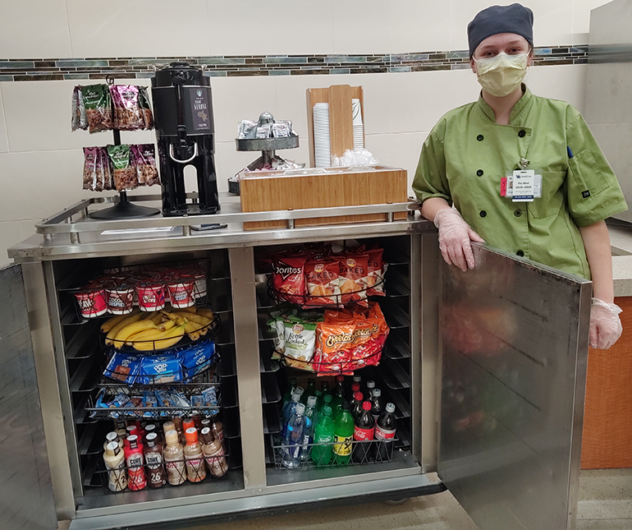
ELEVATE THE DINING EXPERIENCE IN SENIOR LIVING
Don’t let your guard down during COVID-19
Source: Food Management
Notes:
Snack or Hydration Cart for Happy Hour or Themed Rolling Cart
Re-purpose delivery carts

Slide 35
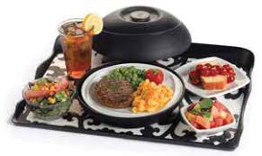
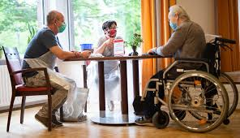
Room Service Dining
Service Considerations for that Special Touch
Theme and “Surprise” Meals
Dining Table & Real China
Placemats
Scented towelettes
Garnishing
Personal Notes
Support
Image
here
Notes:
Service Considerations for that Special Touch
Plan ideas to encourage engagement with each resident,
Those “Larger Scale” events that you’ve always done can certainly still happen but it will take more planning and creative thinking,
Think about how you can engage on a more-regular basis such as with daily inspirational messages or comedy cards with meals.
Themed meals
Pizza -- One operator out of Minnesota worked with team and came up with a Build Your Own Pizza Day.
Pizza is popular all around, especially a personal-pan sized pizza, custom made just for you!
Dining staff went to each resident’s room and took orders 2 days ahead of time.
After kitchen closed the night before the event, team assembled all pizzas to order
Made turkey clubs for those who opted for a sandwich instead
Served next day for lunch delivery in room.
Delivered to them by culinary team wearing chef hats and Italian colors!
Dessert Bake-Off: Colorado AL facility.
Residents submitted family recipes
Four were selected as finalists
Residents got to sample and vote for their favorites during the Bake-Off Contest
Surprise Meals:
Elegant Entrée Selections: Country Meadows Retirement Community in Pennsylvania
Every day, kitchen staff went to the rooms of 10 residents
Surprised them with four upscaled menu choices for dinner.
Options included Blackened Salmon, Fiesta Chicken, Mushroom Wellington, and Beef Tenderloin.
“The chef prepared and personally delivered the dinner to those residents that same evening.
Worked through the full community so all had the opportunity.
Dining Table -- So simple -- What are they eating on?
Knowing communal dining wouldn’t be happening for a while, a local customer took those tables from dining room and put a table in each resident's room so they had a nice place to enjoy the meal → making it more of an experience
Nicer placemats -- sanitizable, reusable (not paper) -- Saw these in your sample box if you registered in advance
Scented towelettes to clean hands -- Can really get fancy with heated towel warmer and offer residents warm towel when entering dining area
Garnishing -- Something seasonal? Gourds
Personal Notes -- card written by your staff or from local K12 schools/students, quick note ON their food box….

Slide 36
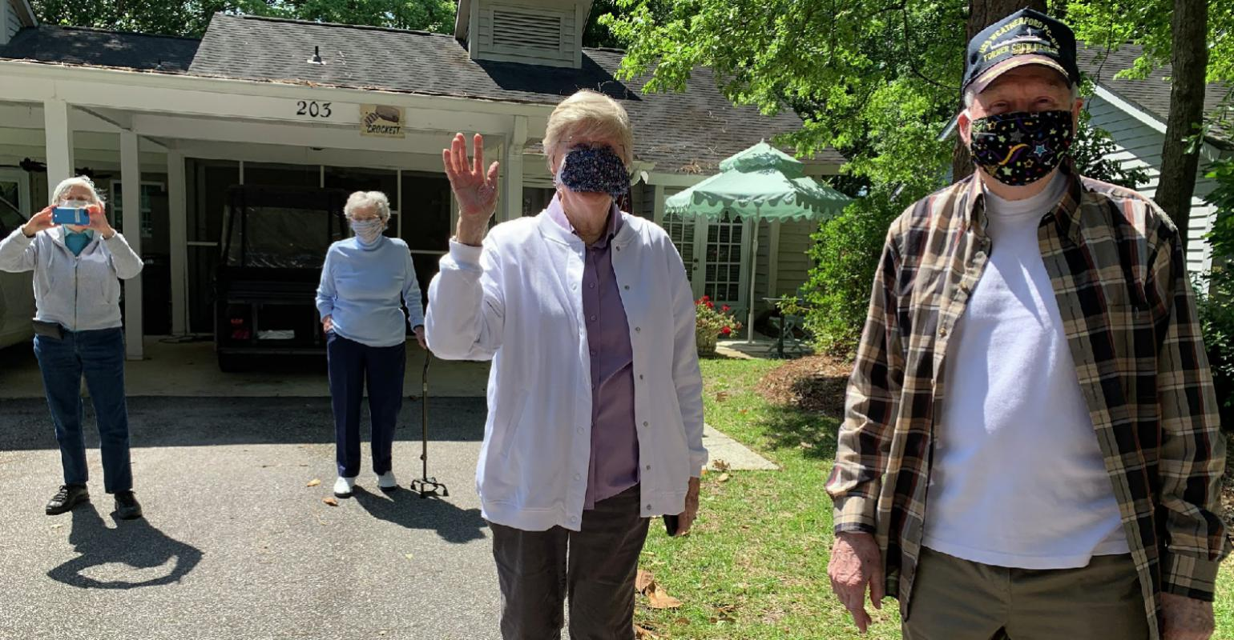
Senior dining chef live streams cooking videos to residents’ apartments during quarantine
Notes:
Senior dining chef live streams cooking videos to residents’ apartments during quarantine
Chef Eileen Goos and friends at the outdoor version of her new live-streaming cooking show, a way for the dining team to connect with senior residents during the coronavirus crisis.
Using technology to elevate the dining experience can be an excellent option. We talked about it briefly with using a digital system to take orders, but it can be used for activities to bring people together safely, as well. This idea of streaming activities into the room if getting out is not possible is a fun solution. Another example from a community is a
Zoom Cocktail Party -- Salem explained that the communication between Christina Hall, Director of Life Enrichment Department, and Arnoldo Marquez, IT Director, and his IT team made the event go over without any major glitches.
“Right before the start of the Zoom call, we had a cart going around door to door, where they had a choice of jazz-themed cocktails (since a local musician, Ethan Uslan, a ragtime jazz pianist was invited to perform),"
"Tying into the theme, we served Watermelon Gin Rickey and the Gold Rush (bourbon) served in Mason jars.
We sent an invitation with what specialty drinks we would be serving so they would know in advance what they wanted.”
"We had 3 'practice' meetings in the days leading up to the main event, so that the residents could learn how to get on, switch video views, mute and unmute, etc., in advance of the party," Christina said.
"It was really special to be a part of; the excitement on their faces when they first logged on and got to see friends' faces without masks on!
We opened the meeting about 1.5 hours early on the day of the party, so that people had plenty of time to log on, get comfortable, and say hi to neighbors before the 'concert' started, and have a virtual 'cheers!'"

Slide 37
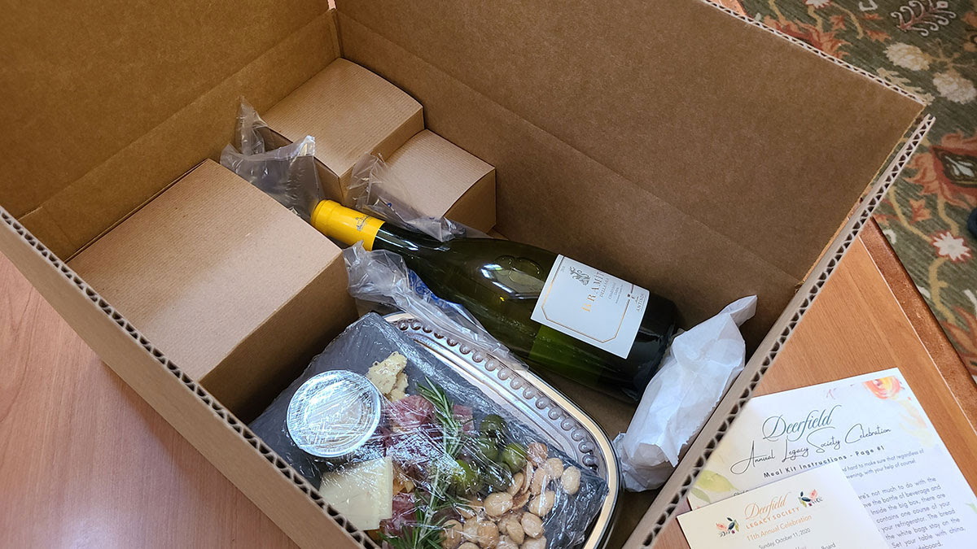
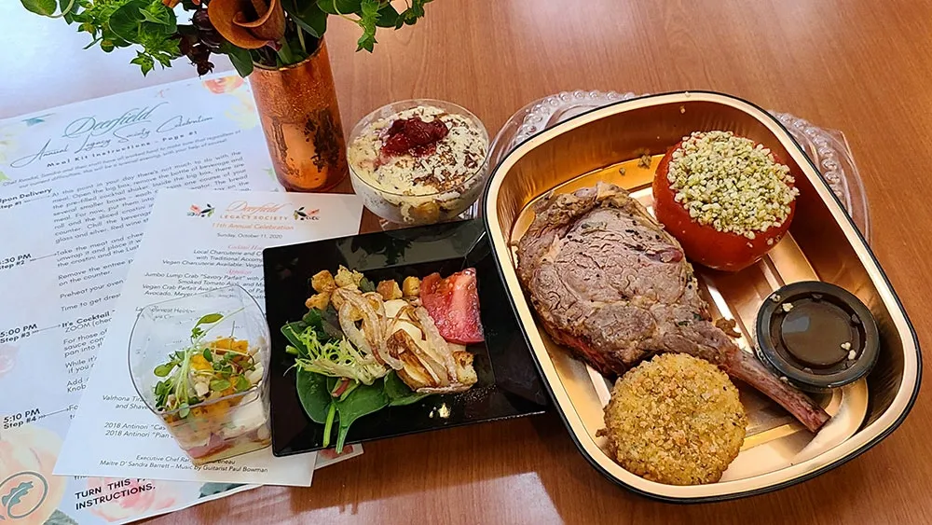
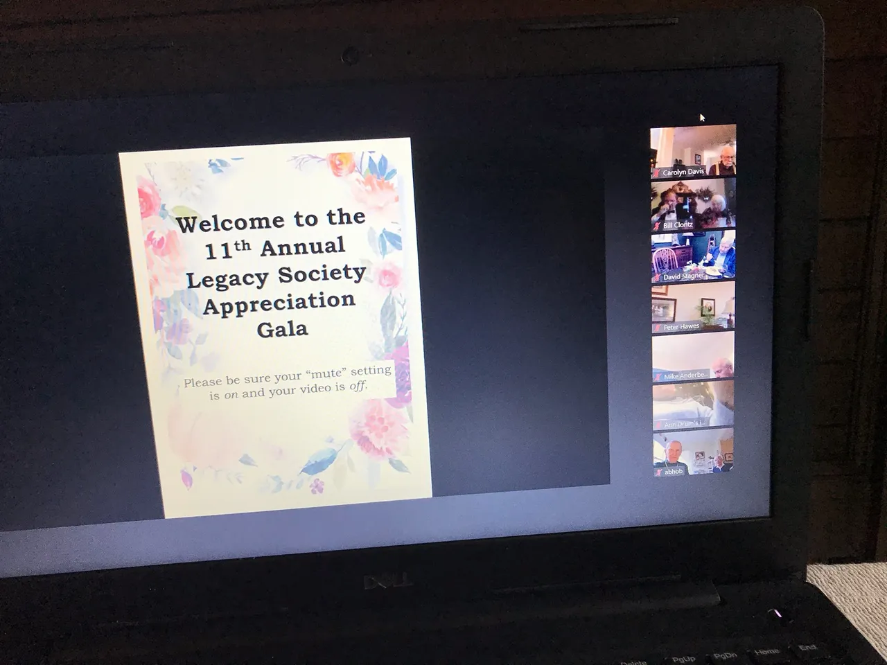
Thinking Outside the Box for an Annual Gala Fundraising 5 course Dinner
Zoom Meeting
Delivered Prior to Event
5 course Meal Delivered Prior to with heating instructions.

Slide 38
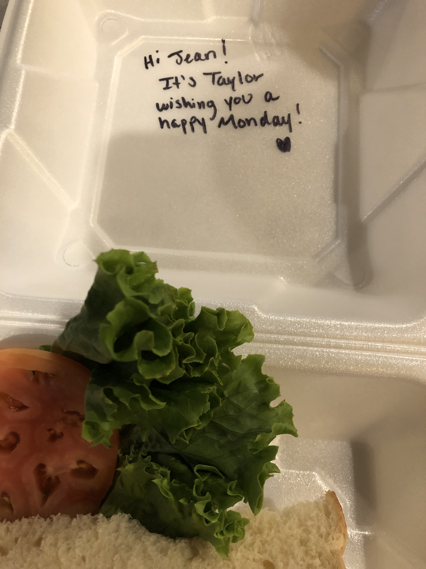
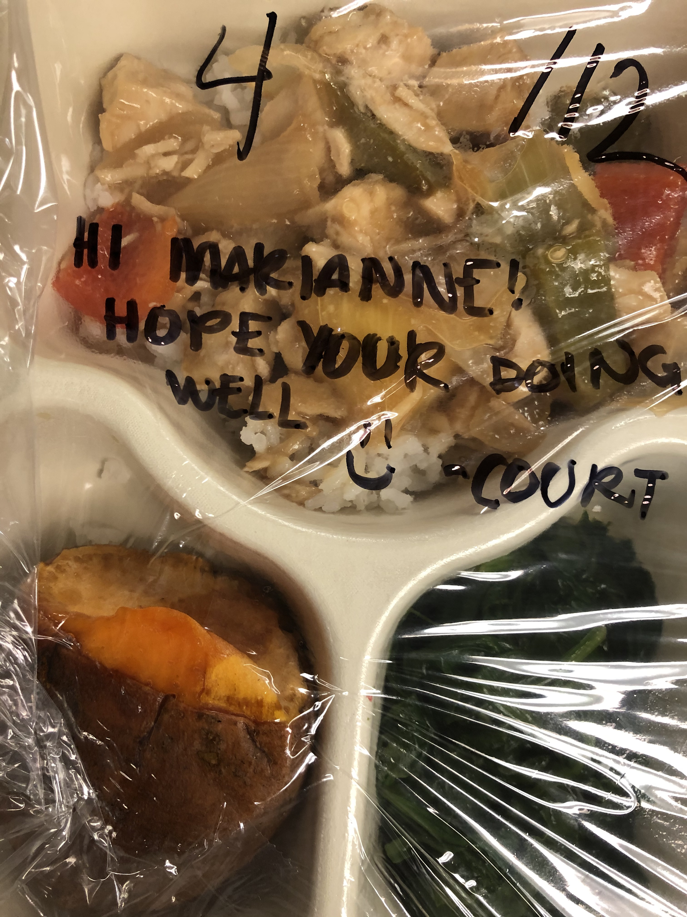
That Personal Touch
Notes:
That personal Touch
Staff writing a short personalized message for each resident.
I loved this idea from one of our customers -- my mom used to put little notes in my lunch box and I can’t tell you how warm I felt when I saw her handwritten note, written out to me specifically, in the middle of the day.

Slide 39
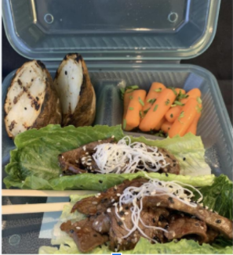
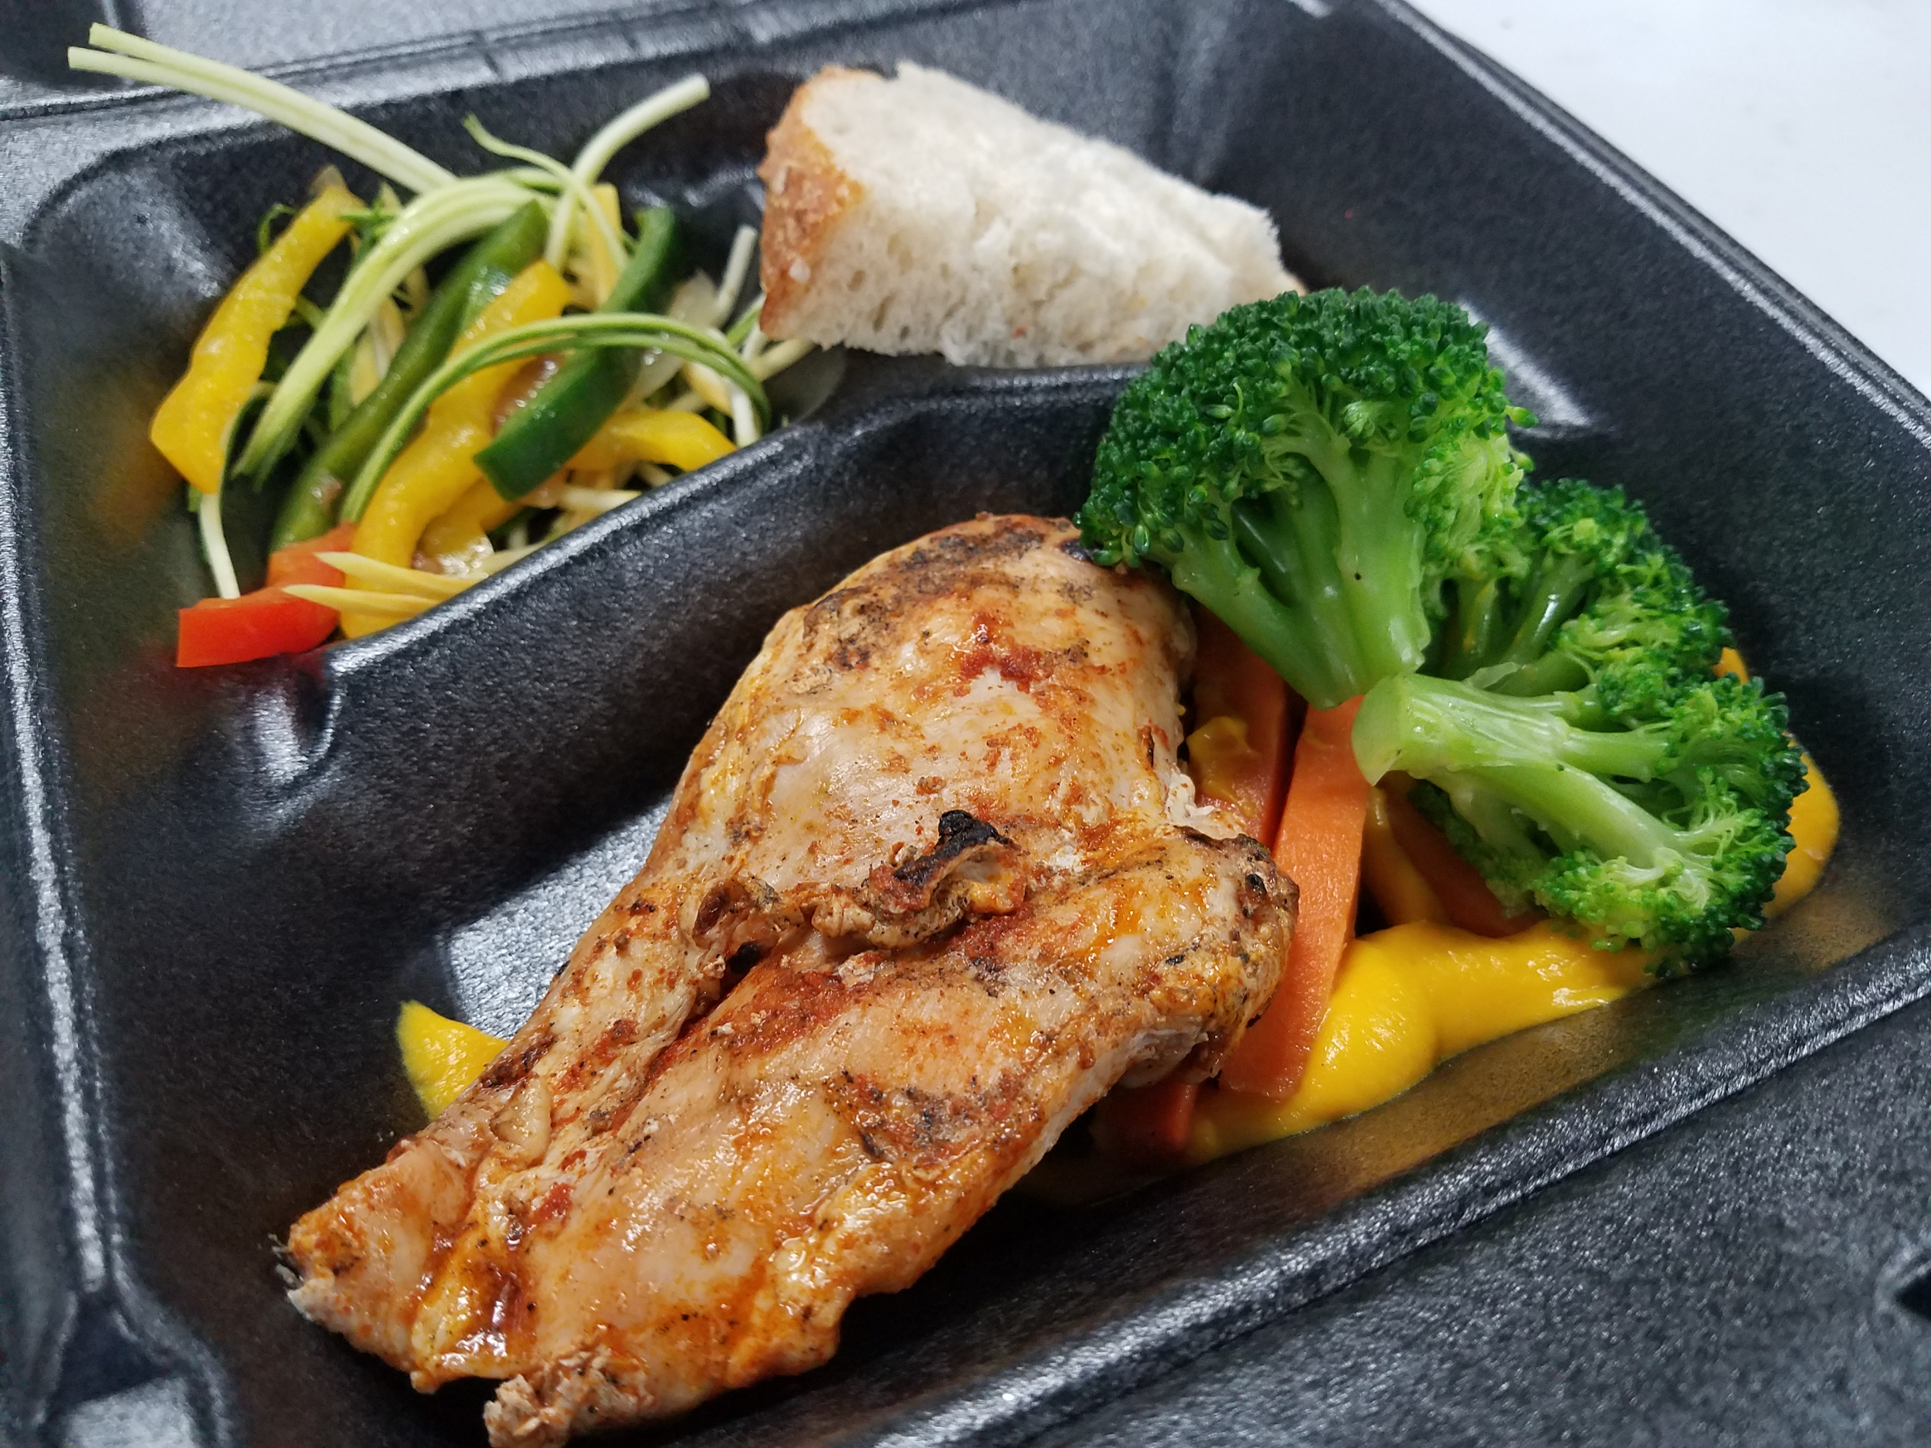
To Go Dining
Keeping the Experience Dignified
Upscale the presentation
Utilize reusable containers that can be brought back for sanitizing
To-Go option for retail outlets and independent and assisted living
Notes:
Want to touch on to-go programs / packaging
We know so many of you are using to-go containers for residents mandated to eat in room
Also a great option for residents in Indep and Assist. Living that don’t yet feel comfortable coming to dining room.
For retail options, an order ahead to-go program def helps to reduce congestion.
Whatever the format, if using to-go containers, will want to upscale the presentation to add visual appeal to the meal -- from what type of packaging used to what food and the way food is put into box
Black to-go box can help make food pop but also look at the color of food in box.
Doesn’t always work but with Color contrasting with correct packaging and food items, can certainly work and Culinary team will talk more on this next week.
Environmentalist in me has cringed at amt of disposables used.
Understand it has its place in certain situations but we’ve seen operators successfully implement re-usable to-go programs with well thought-out programs and procedures
Responds to resident concerns r/t amt of packaging disposed of.
Pictured is one example from G.E.T.
Eco-takeout containers
Dishwasher safe
Other brands also available
Bottom line is that you want to think with a hospitality mindset.
Must meet the residents where they are at.
Make them feel safe and comforted
With planning, you and your staff can elevate the service whether in-room or lucky enough to be able to do this communally.
With that, pass the spatula to Barb.

Slide 40
“The dinner hour is a sacred, happy time when everyone should be together and relaxed.”
Julia Child
Notes:
With that great overview of room service dining comes then the consideration of getting our people back together in their dining environment. I think this quote by Julia Child says it all...the dinner hour is a sacred, happy time when everyone should be together and relaxed. Our goal is to elevate the entire dining experience in all areas to keep our patrons motivated and so holds true for communal dining. If it is possible to bring them together, we need to find a safe and encouraging way to do so and so we will discuss communal dining…

Slide 41
Communal Dining

Slide 42
Five Pillars - Key Healthcare Customer Focus Areas
Considering all of these aspects supports the continued pivot of healthcare business. These pillars are not intended to be sequential. They may overlap, based on timing and relevance of changes you are making.
Cleaning & Sanitizing
Cost Control
Menu
Operations
Staffing
Reinforce and validate sanitation best practices.
Containing cost while providing the best customer experience possible will be a priority.
Menu redesign to accommodate changes in service.
Maintain operational efficiencies through policy and procedure updates as the industry continues to pivot.
Establish safety protocol for all employees.
Focus on staff retention.
The “return to normal” will be a journey, at a pace unique to each geographical region and subsegment..
Notes:
5 pillars- 1:30 min
These are key focus areas that will help guide you in your continued pivot toward a new normal. This will certainly be a journey that will look different for every geographical region and subsegment of our business.
Cleaning/Sanitizing - Healthcare has always been excellent in this area, however, new infection control protocol is in place and best practices will be enforced.
Cost Control - Many hospitals have experienced great loss, as well as other healthcare segments. Containing cost will be of high priority
Menu - redesign to accommodate service and labor changes
Operations - maintaining operational efficiencies in the back and front of the house through policy updates as the industry continues to change
Staffing - Safety and retention of labor is certainly at the forefront of every operator

Slide 43
Communal Dining
Have A Flexible Plan
Expect guests to be cautious about gathering again for meals.
You can reassure them by demonstrating your attention to safety.
Base plan off menu and available staffing
Adjust front-of-house procedures & job descriptions to match needs created by menu changes SeBS
Notes:
We do understand that everyone is in a different space with dining depending on the state and even county that you reside. However, we feel it is extremely important to be ready communal dining when it is allowed for you. As we discussed, we need to do what we can to prevent that dehydration and malnutrition and having that flexibility of getting out of the room, even occasionally, can help.
You need to have a flexible plan for your community based on your dining room and lay out and be able to pivot back to in room dining if necessary.
I have been able to speak to many operators who have returned to communal dining but also have to back to room service if COVID numbers rise. You certainly can expect guests to be cautious about gathering again for meals and it is our job to reassure them by demonstrating our attention to safety. Based on what we just discussed in the 5 pillars, you will want to base your plan off of your menu and available staffing, as well as adjust your operations, both front and back of the house, as well as job descriptions to match needs created by menu changes. All the while, striving for that dining experience that will they will want to continue coming back for..

Slide 44
Communal Dining
Have a visible cleaning strategy - Consider branding it for your community
Communicate what you are doing to residents and families
Increase frequency
Between seatings:
table top and chairs; everything on table
TIP: Eliminate table presets, use rolled silverware, and minimize centerpieces
Notes:
To begin building this confidence in both residents and staff, a visible and clear cleaning strategy should be established. You could even brand or name this new cleaning program for your community or establishment and then communicate it to residents and families, highlighting the increased frequency of cleaning, including between seatings or whatever process is taking place. It is recommended to eliminate table presets, use rolled silverware and minimize tabletop decor to make cleaning easier.

Slide 45
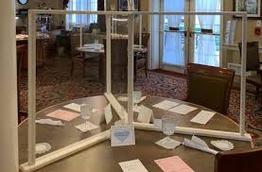
Communal Dining
Social Distancing
Redesign seating arrangements to accommodate social distancing
Remove tables/chairs or mark them as “closed”
Reduce the number of seats at each table
Arrange chairs at tables in order to increase distance from one another
Table top plexiglass dividers
Notes:
Obviously, encouraging social distancing is important in this process, this includes redesigning seating arrangements by removing tables/chairs or marking some as closed. You may reduce the number of seats at each table or arrange chairs at tables in order to create distance. I have heard from one community that they brought out their bedside tables to the dining room to extend their tables in order to create that distance, but keep more people at a table.
We do understand that there is some controversy over tabletop plexiglass dividers depending on the state that you reside, however, we felt that it needed to be mentioned as it may be deemed as a solution in some environments. There are now many resources for these types of dividers because of the pandemic.

Slide 46
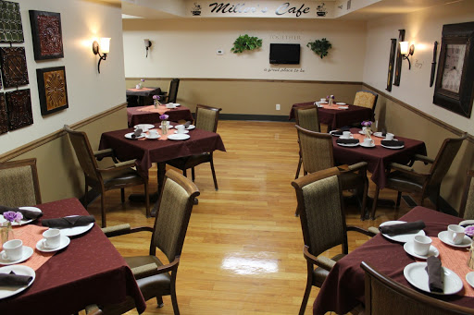
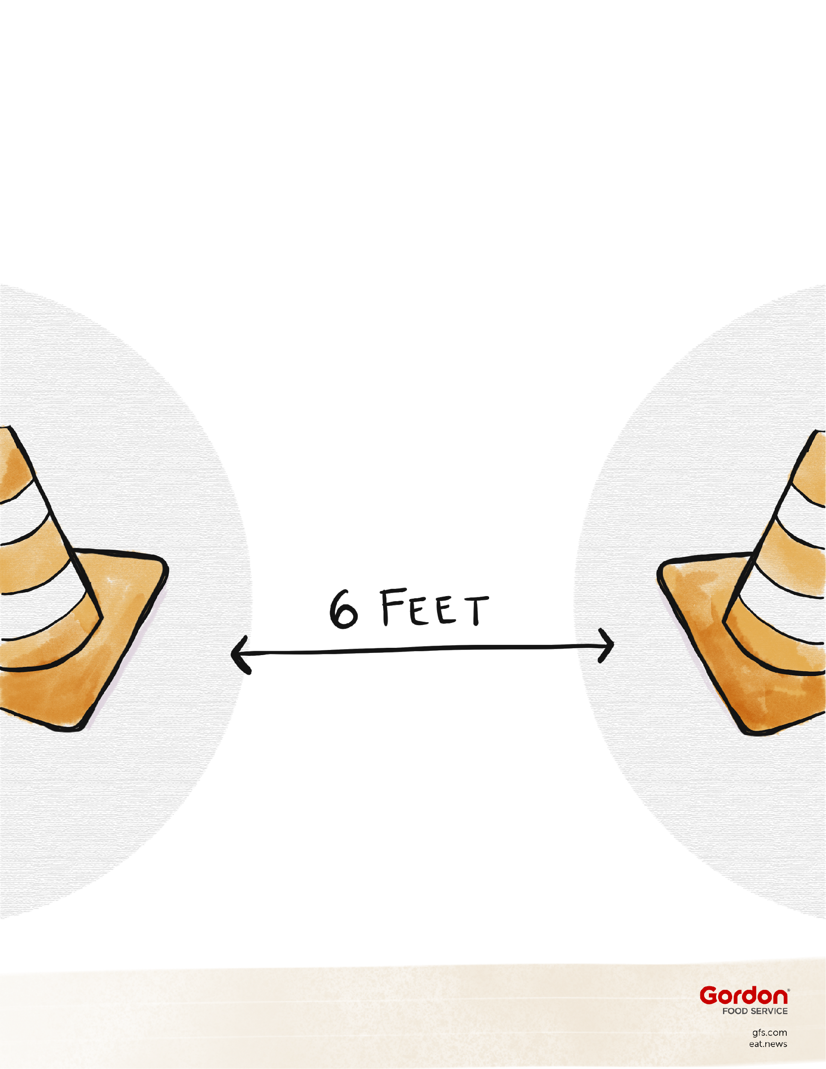
Communal Dining
Social Distancing
Utilize unused space in other areas of your organization as temporary dining
Consider walkways that are narrow or
could be congested
Post Signage
Notes:
Other solutions for social distancing include utliizing unused space in other areas of your community as temporary dining. This is a community that used their hallway to set up their dining area or I have heard of activity rooms, chapels, etc. You must consider walkways that are narrow or could be congested and not allow distancing and of course, post signage to help guide residents to where they need to go in order to keep distance.

Slide 47
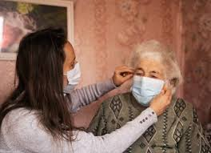
Communal Dining
Before guests enter
Screen guests per your organization guidelines
Provide hand sanitizer
Post Signage
Notes:
After creating that dining area that suits your organization, decide when and where screening will take place. Provide hand sanitizer and signage again, where necessary when entering.

Slide 48
Communal Dining
Menus
Utilize pre-order systems to reduce time in the dining room
If ordering at table, use...
digital ordering, disposable menus or menus that can be disinfected after each use
If using a tablet to collect orders, avoid cross-contamination
Only allow staff to touch it (stand in doorway to take order)
Sanitize devices between uses by different people
Notes:
For the dining experience itself, consider utilizing pre-order systems to reduce time in the dining room. If ordering at the table, use digital ordering, disposable menus or menus that can be disinfected after each use. Avoid cross-contamination by only allowing staff to touch the screen and sanitize between uses if by different people.

Slide 49
Communal Dining
Other considerations:
Alternative seating ideas based on capacity and number of residents desiring to come out of their rooms
Use a reservation system
Phase in on alternate days or meals for each resident (eat in the dining room for lunch, in room for dinner, etc.) based on resident preferences
Use half the tables for one sitting, and the other half for the next
Start slow - try one day or a few times a week to assess operational challenges before expanding
Collaborate with nursing staff to assure assisted diners receive adequate help
Notes:
Other considerations to establish that great dining experience outside of the room is to possibly use a reservation system where residents can pick the time and meal they would like to attend. Also, phase into communal dining by offering dining on alternate days or meals for each resident (eat in dining room for lunch, and in room for dinner) based on resident preferences. Use half the tables for one sitting and the other half for the next to reduce cleaning. As with any change, if you have been doing room service, start slow and try one day or a few tiems a week to assess operational challenges before expanding and be sure to collaborate with nursing staff to assure assisted diners receive adequate help.

Slide 50
Communal Dining
Chef Spotlight Trainings & Chef’s Corner
Training Staff on Talking with Residents
Communication Plan
Engage Your Resident Dining Committee
Notes:
Chef Spotlight Trainings: Before the recent go-ahead was given for reopening dining rooms at Leisure Living Management, Rick Balfour, Director of Culinary and Dining Services, came up with an innovative plan to prepare residents by having small group “Chef Spotlight” sessions. Through these “lunch-and- learn” format trainings, chefs would meet with a group of about 8 residents at a time - with social distancing and mask requirements.
“We were recently given the full green light to reopen dining rooms, but this proposed plan was designed to give chefs the opportunity to talk about the changes necessary for communal dining,” he said. “The sessions would be a way to keep safe residents safe while also showing appreciation and providing an opportunity for them to interact with each other and our chef.” He proposed that all the residents be from the same basic area and rotate groups weekly as a method to keep communication current.
Chef’s Corner: At Roland Park Place in Baltimore, Maryland, they have a “Chef’s Corner” memo where the chef can communicate about what’s going on in dining. “The Chef’s Corner is an effective platform for communicating with residents about the upcoming changes in dining, including the plan for reopening, how to make reservations, new regulations, and what to expect when they are there – like no tablecloths, no shared condiments, limited number of people at a table…” said Melissa Schrimsher, Director of Food and Beverage.
Training Staff on Talking with Residents: At Roland Park Place, they also train their team members on how to communicate with residents. “Our room service coordinator and servers are trained on what to say to residents about the dining room plans – how to make reservations, wearing a mask, and other regulations,” Melissa explained. “Our staff talk to them every day when meal orders are taken, then servers follow up with them on the phone after they make deliveries. So it’s important that our team is familiar with the new regulations and how to explain what our dining rooms will look like to prepare and set expectations for our residents.”
Communication Plan: Before opening dining rooms, Kari Robinson, Regional Director of Nutrition and Culinary for Cassia, said that several of their sites developed a communication plan where they went from apartment to apartment, delivering the rules in writing. “The teams delivered the guidelines in person and explained, ‘These are the rules to keep you safe. Wear your mask to the dining room. There’s hand sanitizer for you when you come in and leave, stand 6 feet apart,” she said. “Most of them understood and were just excited to return.”
Engage Your Resident Dining Committee: “As dining services in communities move into the first phase of reopening, restart your Resident Dining Committee,” said Harris Ader, Found of Senior Dining Association. “Give residents on the committee a voice – and a sense of purpose so they can be part of the solution. If they understand the rollout plans, they can be your ambassadors and inform other residents about what’s going on as your ease into reopening dining rooms. Get their ideas and have a resident-centered brainstorming session and make it as constructive as possible.”
Reservations, hand sanitizing, mask use, table capacity limits, staying at assigned tables, no tablecloths or shared condiments…it’s a lot. Make sure you’ve properly communicated with residents on what to expect and how to prepare.

Slide 51
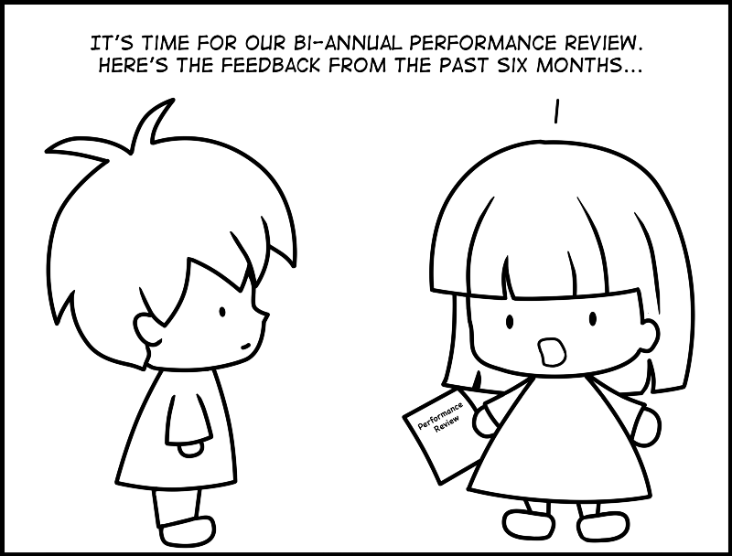
Room Service and Communal Dining
Keeping the Experience Dignified
Opportunity for feedback
Regular intervals throughout the cycle
During meal
Involvement
Sample and vote contests
Notes:
Are you giving them an opportunity for feedback?
On a regular basis -- not once every 6 months
Sample and Vote events ( Can call it “Your Voice Counts!”)
Opportunity to try out potential new menu items
Offer 3-4 new options from menu category (dessert, beverage, salad, etc…)
Provide to residents in small portions and ask for voting / feedback
Share results
Add to menu

Slide 52
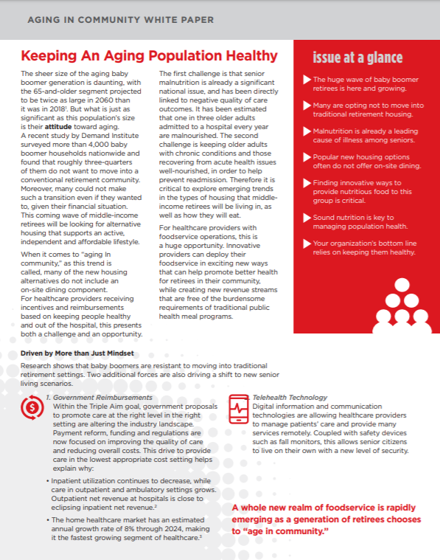
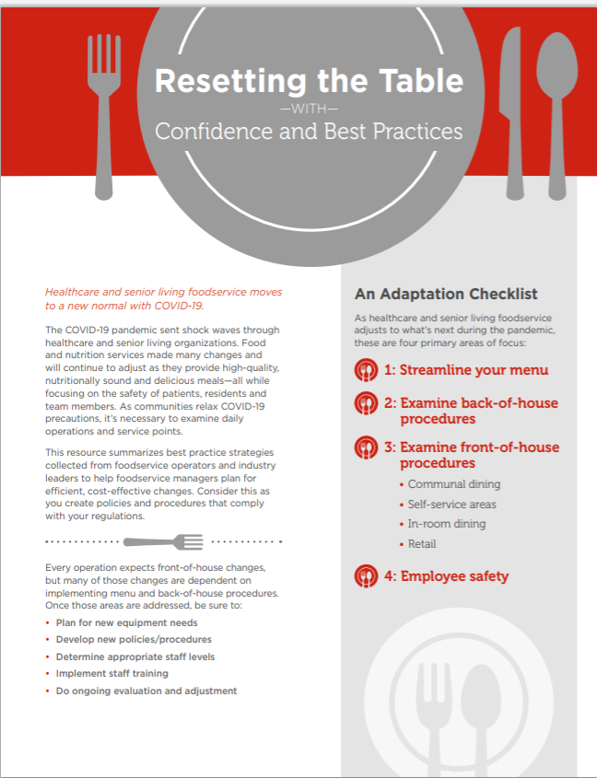
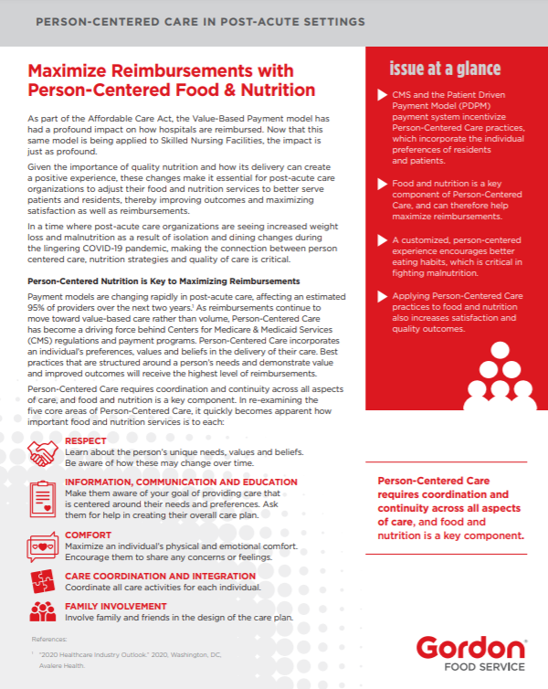
GORDON FOOD SERVICE WHITE PAPERS

Slide 53
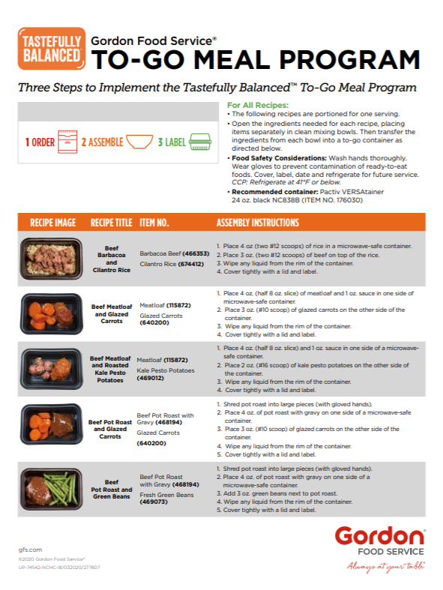
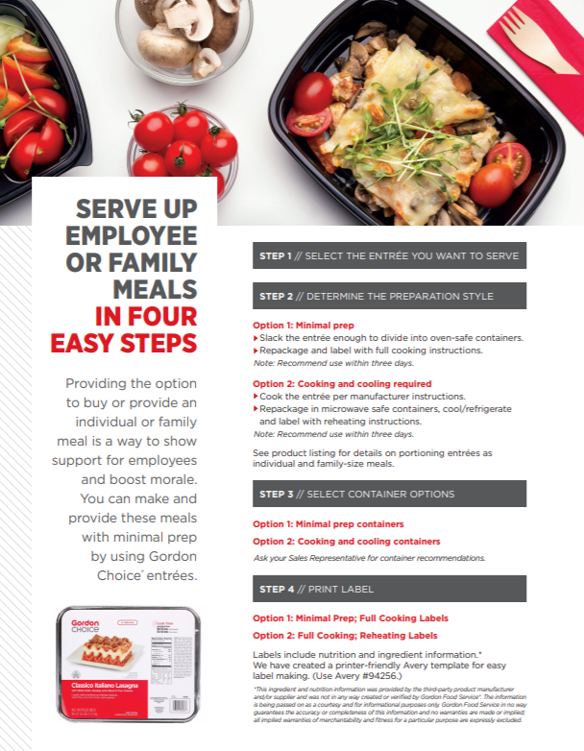
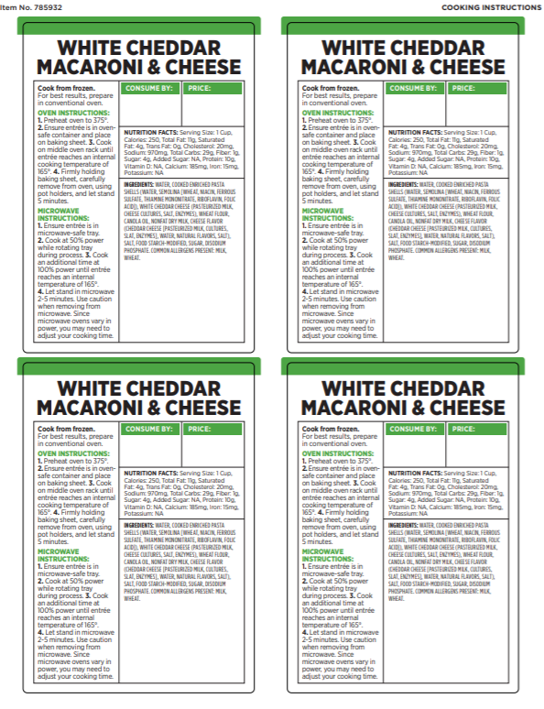
GORDON FOOD SERVICE PRODUCT SOLUTIONS

Slide 54
Questions?
Notes:
Interim Infection Prevention and Control Recommendations for Healthcare Personnel During the Coronavirus Disease 2019 (COVID-19) Pandemic
“Management of laundry, food service utensils, and medical waste should also be performed in accordance with routine procedures.”
The combination of hot water and detergents used in dishwashers is sufficient to
decontaminate dishware and eating utensils. Therefore, no special precautions are
needed for dishware (e.g., dishes, glasses, cups) or eating utensils; reusable dishware
and utensils may be used for patients requiring Transmission-Based Precautions. In the
home and other communal settings, eating utensils and drinking vessels that are being
used should not be shared, consistent with principles of good personal hygiene and for
the purpose of preventing transmission of respiratory viruses, Herpes simplex virus, and
infectious agents that infect the gastrointestinal tract and are transmitted by the
fecal/oral route (e.g., hepatitis A virus, noroviruses). If adequate resources for cleaning
utensils and dishes are not available, disposable products may be used.

Slide 55
Maria DeNicola, MS, RD, LD/N
maria.denicola@gfs.com
813-340-9692

